Slide 1
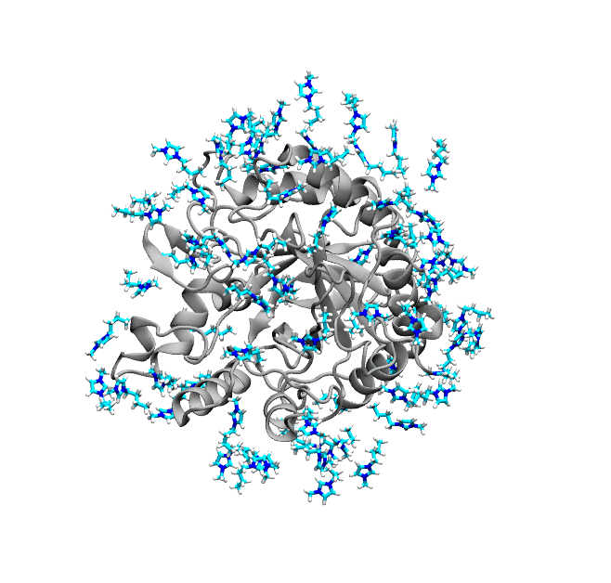
THE VMD

Slide 2
Outline
What is VMD?
What do we use VMD for?
Desktop vs on Hyak
Rendering Images
TCL Scripting
Creating gifs

Slide 3
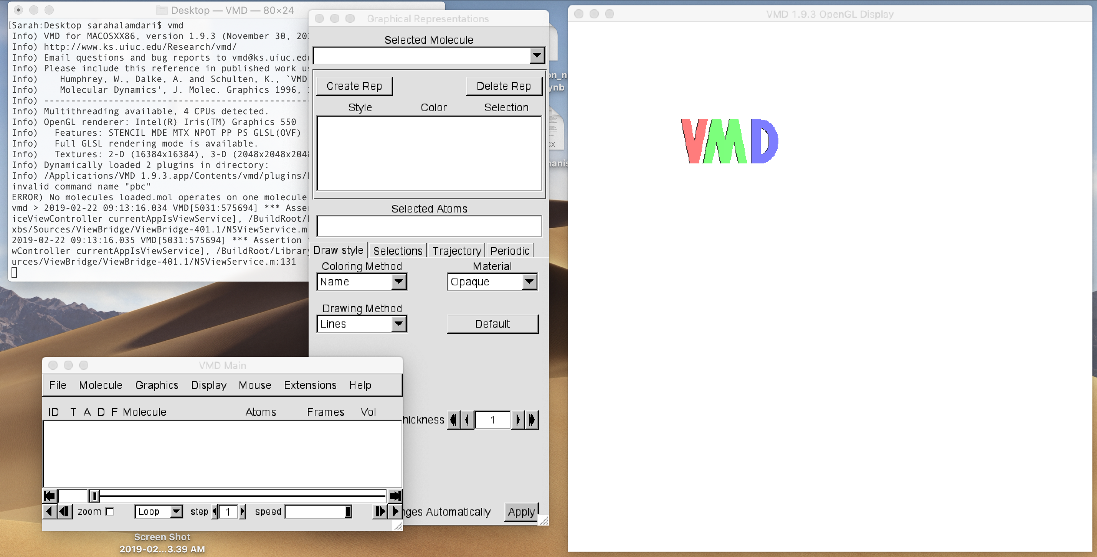
Who has used VMD?/ What have you used it for?

Slide 4
What do we use VMD for?
Doesn’t look like much, but its super powerful ☺
3D graphics – publication ready images of the systems we work with
Attractive to use in presentations/papers
Quick Scripting (TCL)
Some molecular functionality (similar to some simple gmx tools: radial distribution functions, rmsd, etc.)

Slide 5
Where to get VMD?
Installed on Hyak(ikt and mox) -> if you don’t have these paths contact someone in PRG
Hardware requirements:
MAC: XQuartz version 2.7.8
Windows: Xming (newest version should work)
It is MUCH faster on a desktop
Especially on a Mac
Undergrads: we have 2 shared computers in B17 you can use if you’re having trouble setting it up on your own!

Slide 6
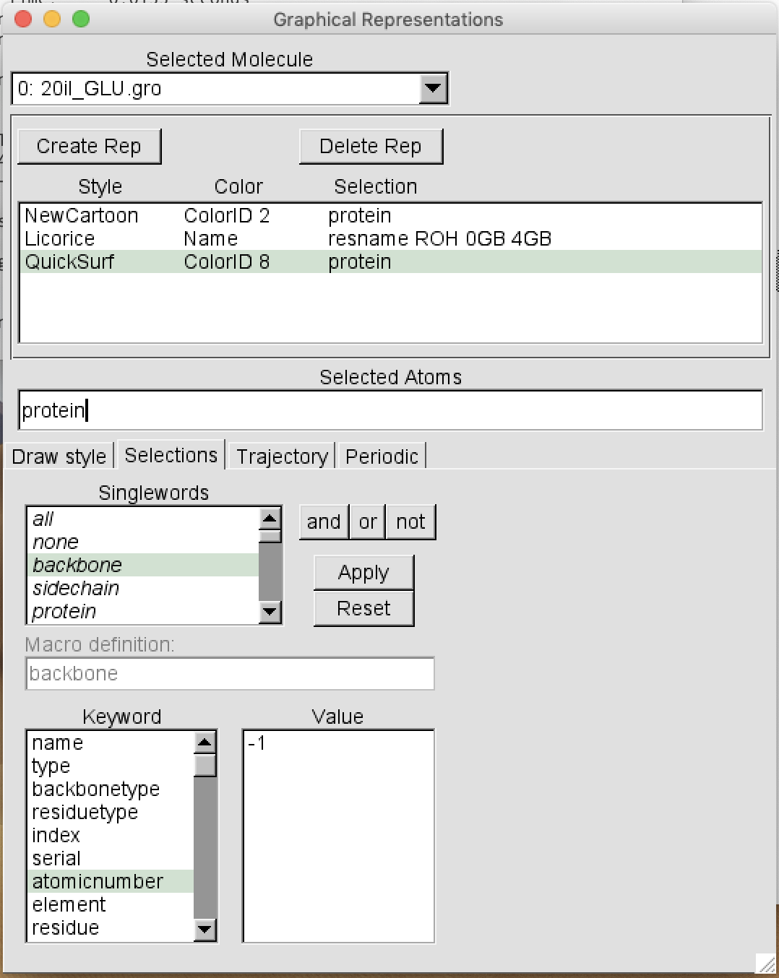
Atom Selection
Lazy way (Sarah’s way):
Resources for becoming familiar with atom selection
Resource: https://www.ks.uiuc.edu/Research/vmd/vmd-1.3/ug/node132.html
Not “intuitive”

Slide 7
Post processing trajectories (to fix pbc issues)
gmx_mpi trjconv –f traj.trr –pbc whole –o trajout.xtc

Slide 8
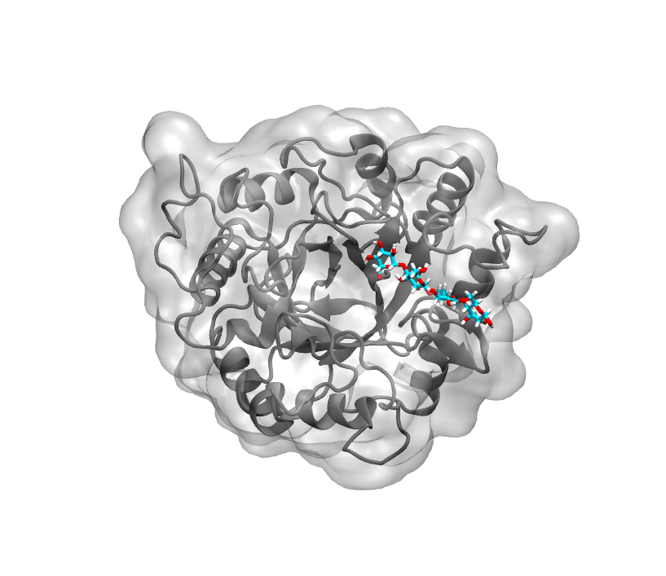
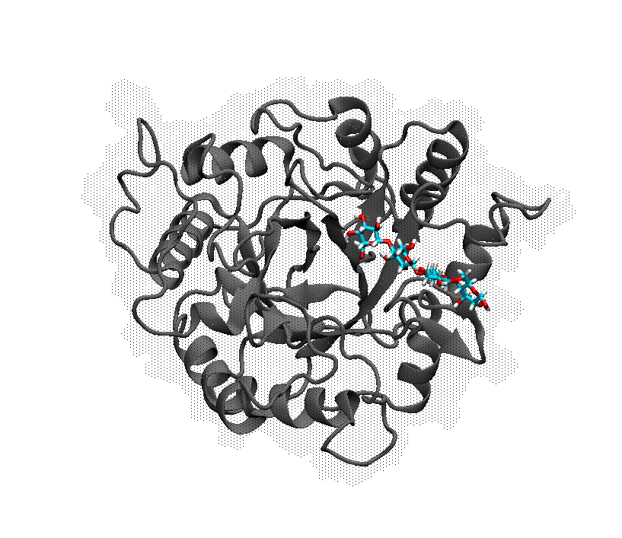
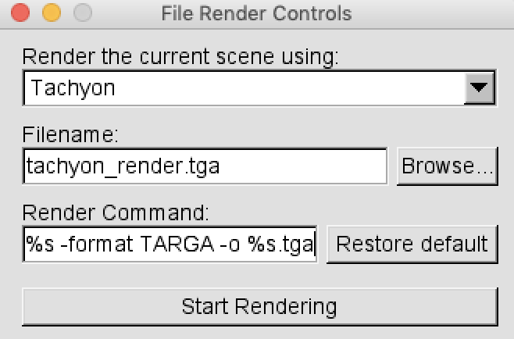
Rendering Images
Rendered with Snapshot
PROS: renders exactly as shown on desktop, renders quickly
CONS: not great quality
Rendered with Tachyon
PROS: renders nicer, control over shading/colors
CONS: takes longer to render

Slide 9
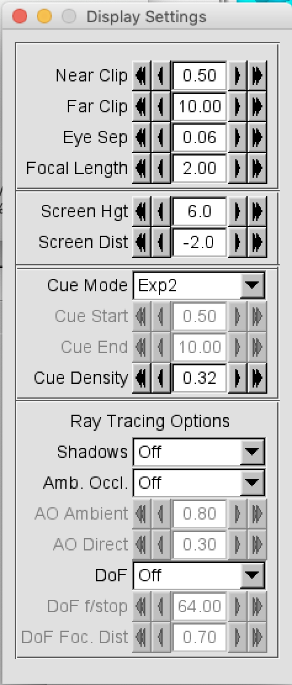
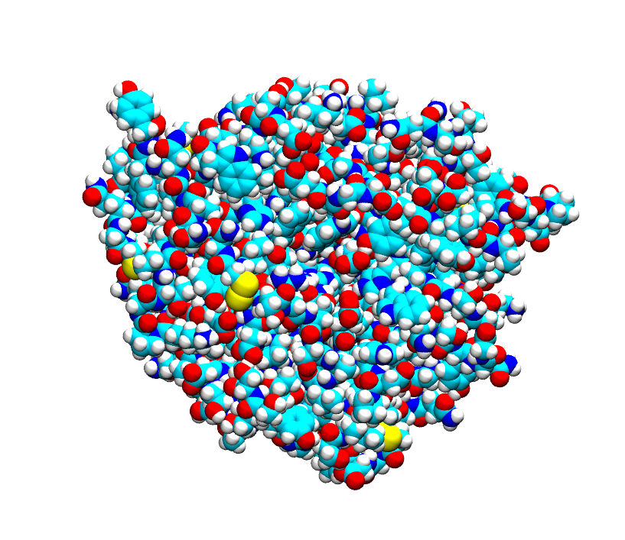
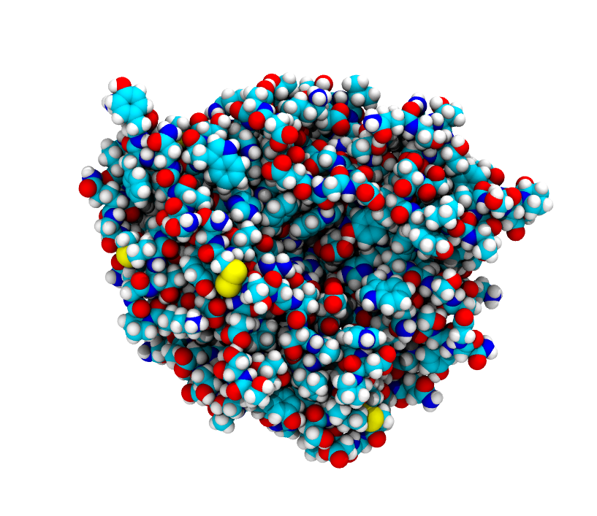
Control shading/lighting (Tachyon Rendering ONLY)
Without Shading/Lighting Shading/Lighting on

Slide 10
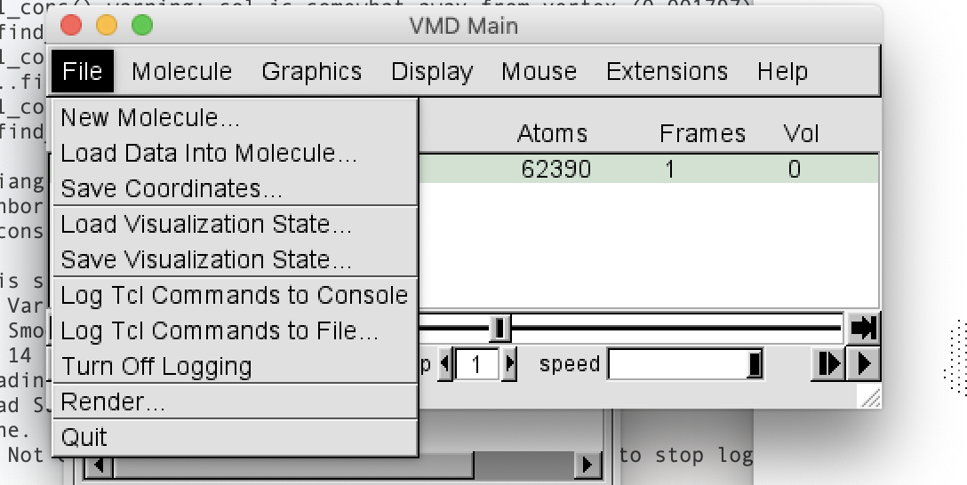
Using TCL commands to control your viewing pane
Not super intuitive– new language
Resources:
Simple Tutorial: https://www.ks.uiuc.edu/Training/Tutorials/vmd/tutorial-html/node4.html
Script Libraries: https://www.ks.uiuc.edu/Research/vmd/script_library/
Training tutorials: http://vintage.fh.huji.ac.il/~ais/vmd_tutorial/VMD_tcl.pdf
Exhaustive documentation (this one rules): http://www.ks.uiuc.edu/Training/Tutorials/vmd-imgmv/imgmv/imgmv-tutorial.pdf
Lazy way:

Slide 11
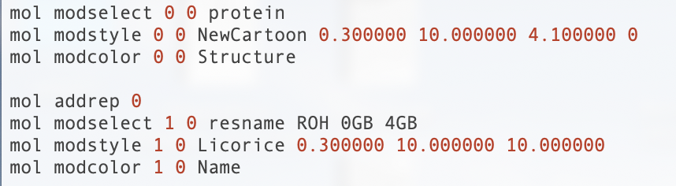
Loading in preset TCL scripts
$ play state.tcl

Slide 12
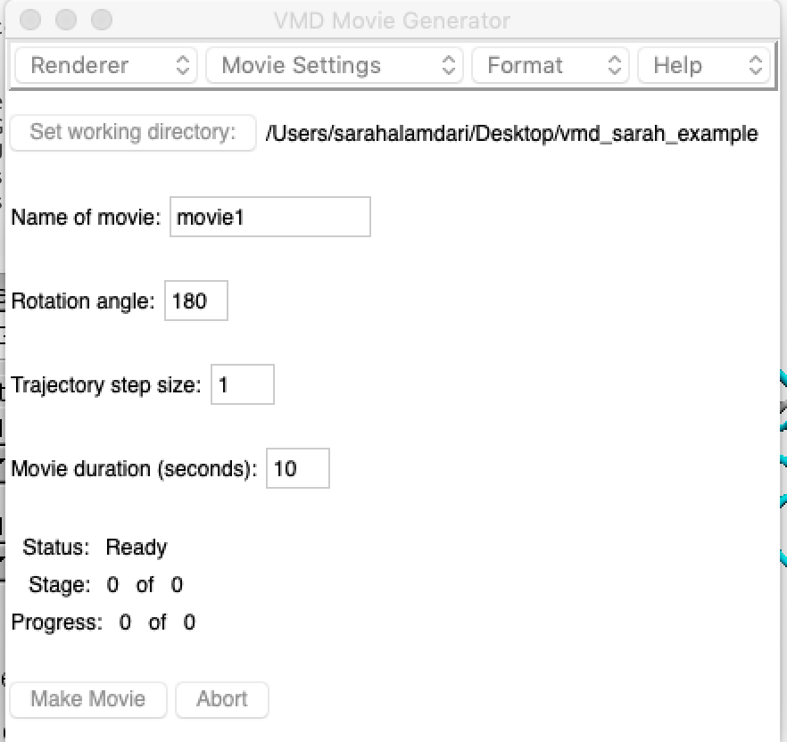
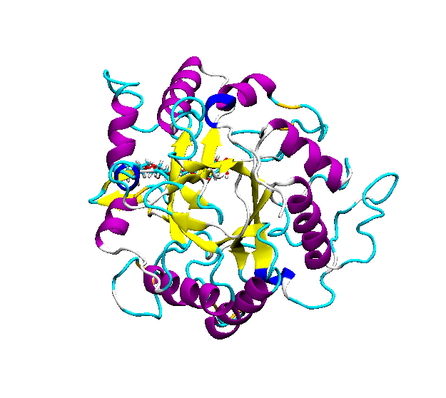
Making Videos/Gifs
Same concept -> https://www.ks.uiuc.edu/Training/Tutorials/vmd/tutorial-html/node3.html#SECTION00034100000000000000
Extensions/Visualizations/VMD Movie Maker

Slide 13
Assignment
Download a PDB from https://www.rcsb.org/ and render 3 unique images
Create your own state.tcl script that loads preset VMD settings for 1 of your images
Create a single frame ’gif’

